Slide 1
Capstone Project-2
Seoul Bike Sharing Demand
Prediction
Rohit Meshram

Slide 2
Content:
Problem Statement
❑ Data Description
Data Pipeline
❑ Exploratory Data Analysis
❑ Models performed
❑ Model Validation & Selection
❑ Evaluation Matrix of All the models
❑ Model Explainability - SHAP
❑ Challenges
❑ Conclusion

Slide 3

Problem Statement
Currently Rental bikes are introduced in many urban cities for the
enhancement of mobility comfort. It is important to make the rental bike available and accessible to the public at the right time as it lessens the waiting time. Eventually, providing the city with a stable supply of rental bikes becomes a major concern. The crucial part is the prediction of bike count required at each hour for the stable supply of rental bikes.
Netflix:
Database:

Slide 4
Data Description
Dependent variable:
• Rented Bike count - Count of bikes rented at each hour
Independent variables:
• Date : year-month-day
• Hour - Hour of he day
• Temperature-Temperature in Celsius
• Humidity - %
• Windspeed - m/s
• Visibility - 10 m
• Dew point temperature - Celsius
• Solar radiation - MJ/m2
• Rainfall - mm
• Snowfall - cm
• Seasons - Winter, Spring, Summer,
Autumn
• Holiday - Holiday/No holiday
• Functional Day - NoFunc(Non
Functional Hours), Fun(Functional

Slide 5
EDA
● Snowfall – cm
● Seasons - Winter, Spring, Summer, Autumn
● Holiday - Holiday/No holiday
● Functional Day - NoFunc(Non Functional Hours), Fun(Functional hours)
This dataset contains 8760 lines and 14 columns
Numerical variables - temperature, humidity,wind,visibility,dew point temp, solar radiation,rainfall,snowfall
Categorical variables - seasons,holiday and functioning day
Rented bike column - which we need to predict for new observations

Slide 6
Data Pipeline
● Exploratory Data Analysis (EDA): In this part we have done some
EDA on the features to see the trend.
● Data Processing: In this part we went through each attributes and
encoded the categorical features.
● Model Creation: Finally in this part we created the various models.
These various models are being analysed and we tried to study
various models so as to get the best performing model for our project

Slide 7
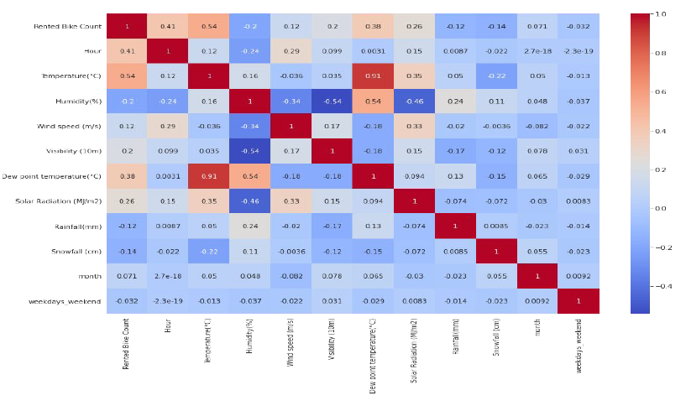
EDA - Feature Correlation

Slide 8
From the heat map we observed that :
Temperatures are highly correlated.
There is a positive correlation between bike rentals
counts and temperature.
We observed a correlation between bike rentals counts
and humidity. The more the humidity, the less people
prefer to rental bikes.
Bike rentals counts has a weak dependence on wind
speed.

Slide 9
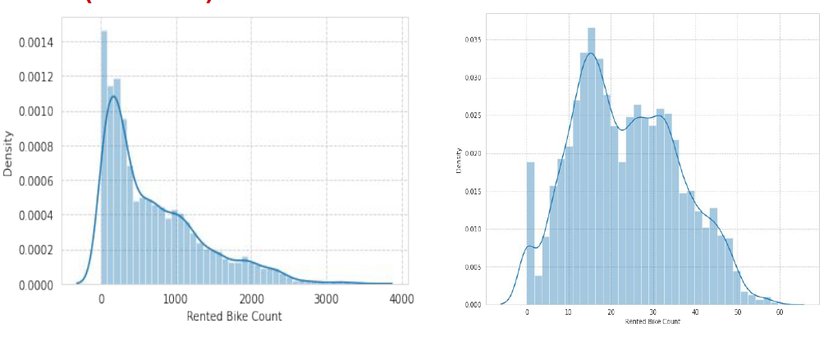
Distribution of rented bike count
EDA (contd...)
Square root transformation of rented bike count

Slide 10
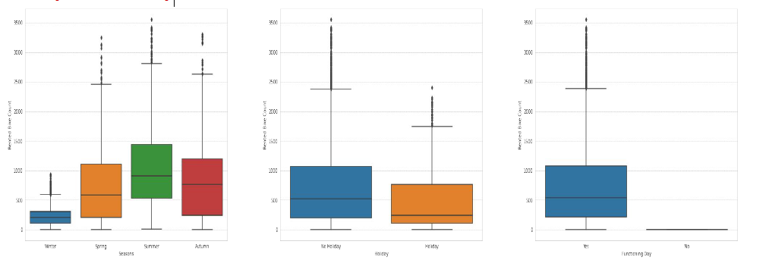
EDA (contd...)
Less demand on winter seasons
• Slightly Higher demand during Non holidays
• Almost no demand on non functioning day

Slide 11
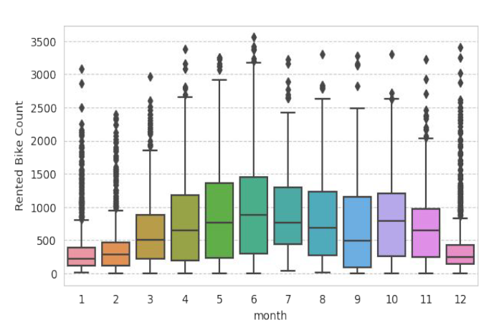
EDA (contd...)
We can see that
there less demand
of Rented bike in the
month of December,
January, February
i.e. during winter
seasons
• Also demand of bike
is maximum during
May, June, July i.e
Summer seasons

Slide 12
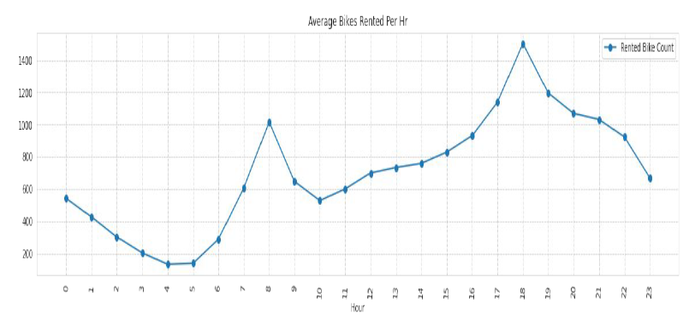
EDA (contd...)
High rise of Rented Bikes from 8:00 a.m to 9:00 p.m means people prefer rented bike during rush hour.
we can clearly see that demand rises most at 8 a.m and 6:00 p.m so we can say that that during office opening and closing time there is much high demand
CodeText

Slide 13
Model’s Performed
Linear Regression with regularizations
Polynomial Regression
K nearest neighbours
Decision tree
Random forest
Gradient Boost
eXtreme Gradient Boost
lightGBM
CatBoost

Slide 14
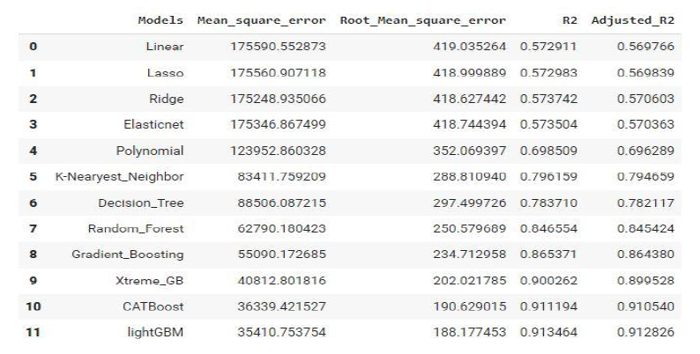
Model’s Evaluation Matrices

Slide 15
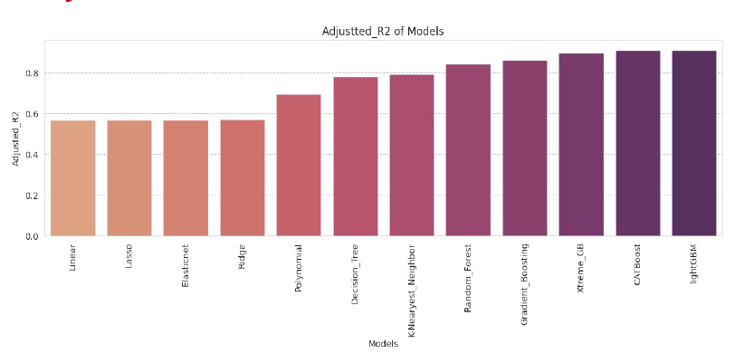
Adjusted R2 of Model’s Performed

Slide 16
Model Validation & Selection(continued)
● Observation 1: As seen in the
Model Evaluation Matrices table,
Linear Regression, KNN is not
giving great results.
● Observation 2: Random forest &
GBR have performed equally
good in terms of adjusted r2.
● Observation 3: We are getting
the best results from lightGBM
and CatBoost.

Slide 17
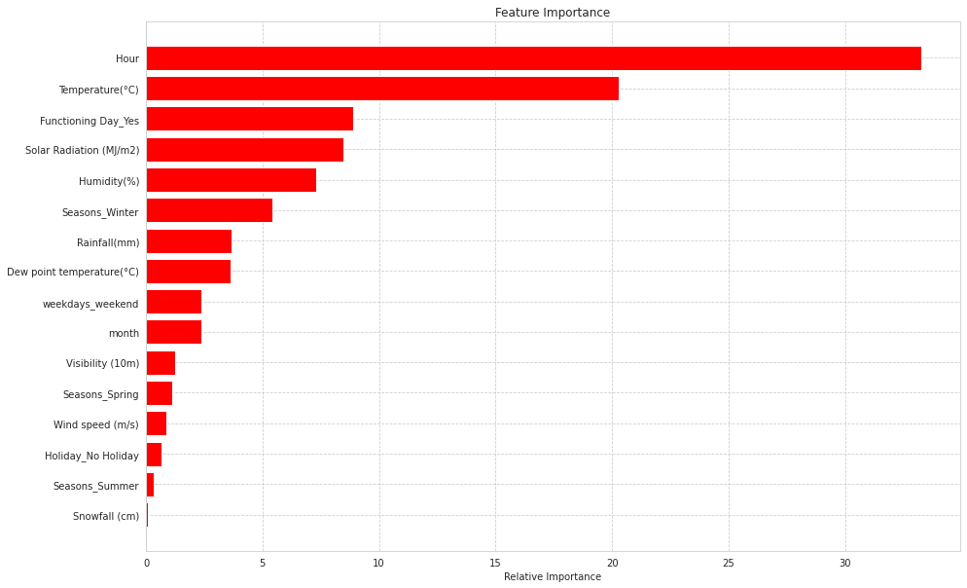
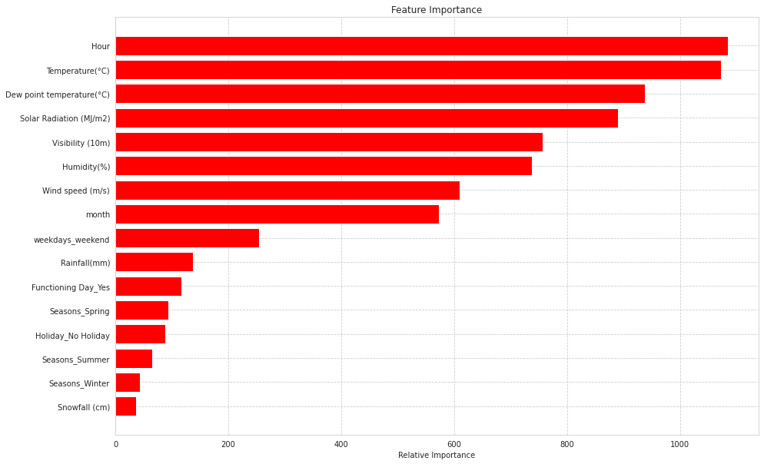
Feature Importance

Slide 18
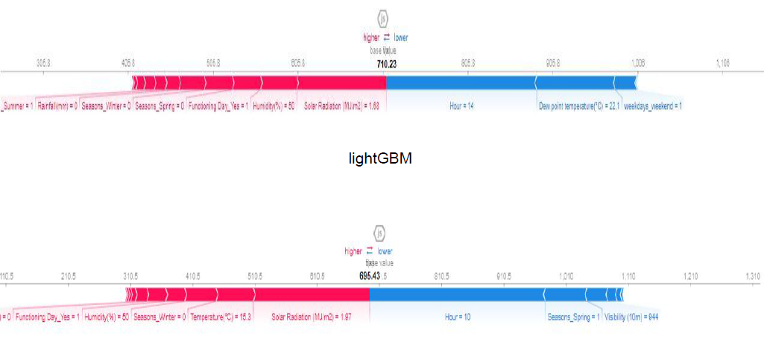
Model Explainability - SHAP

Slide 19
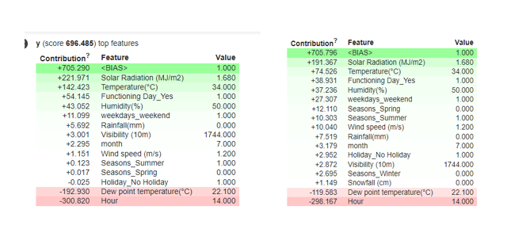
Model Explainability
The green color shows how much the feature contributes to the prediction of the respective class and the weights are positive for the green color.
The red color has negative weights that indicate the feature isn't contributing to the prediction of that class.
It can be observed from the above output, eli5 shows us the contribution of each feature in predicting the output.

Slide 20
Challenges
● A huge amount of data needed to be dealt while doing the project which is quite an
important task and also even small inferences need to be kept in mind.
● As dataset was quite big enough which led more computation time.

Slide 21
Conclusion
1. In holiday or non-working days there is demands in rented bikes.
2. There is a surge of high demand in the morning 8AM and in evening 6PM as the people might be going to their work at morning 8AM and returing from their work at the evening 6PM.
3. People prefered more rented bikes in the morning than the evening.
4. When the rainfall was less, people have booked more bikes except some few cases.
5. The Temperature, Hour & Humidity are the most important features that positively drive the total rented bikes count.
6.After performing the various models the lightGBM and Catboost found to be the best model that can be used for the Bike Sharing Demand Prediction since the performance metrics (mse,rmse) shows lower and (r2,adjusted_r2) shows a higher value for the lightGBM and Catboost models !
7. We can use either lightGBM or catboost model for the bike rental stations.

Slide 22
Thank You

